Slide 1
Lecture 2c Algorithms 2

Slide 2
Some more examples

Slide 3
Example 2: Integer multiplication
American method
British method
Multiplying through addition
Russian method
[Brassard]

Slide 4
Example: American multiplication
4
American method
Multiply numbers x[1,m] and y[1,n]
x = 27 m = 2
[2 1]
y = 431 n = 3
[3 2 1]

Slide 5
Example: American multiplication
27
x 431
-------------------
27
81
108
-------------------
11637
27
x 431
-------------------
7
20
210
600
2800
8000
-------------------
11637

Slide 6
Example: American multiplication
American method
result = 0
for i=0 to n-1
for j=0 to m-1
result=result+shift(tableMultipl(x[i],y[j]),i+j))
6

Slide 7
theMultTable= {(0,0):0,(0,1):0,(0,2):0,(0,3):0,(0,4):0,
(0,5):0,(0,6):0,(0,7):0,(0,8):0,(0,9):0,
(1,1):1,(1,2):2,(1,3):3,(1,4):4,
(1,5):5,(1,6):6,(1,7):7,(1,8):8,(1,9):9,
(2,2):4,(2,3):6,(2,4):8,
(2,5):10,(2,6):12,(2,7):14,(2,8):16,(2,9):18,
(3,3):9,(3,4):12,
(3,5):15,(3,6):18,(3,7):21,(3,8):24,(3,9):27,
(4,4):16,
(4,5):20,(4,6):24,(4,7):28,(4,8):32,(4,9):36,
(5,5):25,(5,6):30,(5,7):35,(5,8):40,(5,9):45,
(6,6):36,(6,7):42,(6,8):48,(6,9):54,
(7,7):49,(7,8):56,(7,9):63,
(8,8):64,(8,9):72,
(9,9):81}
def multTable(a,b):
if a>b:
a,b=b,a
return theMultTable[(a,b)]
In module

Slide 8
def shift(x,i,j):
return x*10**(i+j)
#Note: x=amerMult([1,7],[4,5,2]) corresponds to data 71 and 254
def amerMult(a,b):
result=0
for i in range(len(a)):
for j in range(len(b)):
result=result+shift(multTable(a[i],b[j]),i,j)
return result
>>> from myLib import *
>>> x=amerMult([7,1],[3,5,2])
>>> x
4301
In shell

Slide 9
for
for i in range(n): is equivalent to
for i in range(0,n):
for i in range(3,7):
for i in range(2,10,2) 2,4,6,8
list(range(2,10,2)) generates [2,4,6,8]
list(range(5,0,-1)) generates [5,4,3,2,1]
range(start,stop,step)
Does not include n; up to n-1 !!!

Slide 10
Example: American multiplication
m*n [additions of multiposition numbers +
multiposition shifts + accesses to table of 1-digit multiplication ]
If m=n O(n²)

Slide 11
Recall: Elementary operation
Elementary operation is an operation that is upperbounded by a constant amount of time regardless of the input (instance)
Most importantly, this time does not depend on the size of the instance
Above, all operations are elementary:
addition of two numbers
shift
access to table

Slide 12
Example: British multiplication
27
x 431
-------------------
27
81
108
-------------------
11637
American
27
x 431
-------------------
108
81
27
-------------------
11637
British

Slide 13
Example: British multiplication
Analysis – same result as American multiplication
13

Slide 14
Multiplication through addition
x * y = 0 + x + x + … + x
or: x * y = x + x + … + x
y times
result = 0
for i in range (y):
result += x
y - 1 times
result = x
for i in range (y-1): result += x

Slide 15
Multiplication through addition
y additions y < 10^{n}
O(10^{n})

Slide 16
Russian multiplication
x * y
If x = 2k x*y = 2k*y = k*2y
If x = 2k+1 x*y = (2k+1)*y = k*2y + y

Slide 17
Russian multiplication
371 * 25 25
185 50 50
92 100
46 200
23 400 400
11 800 800
5 1600 1600
2 3200
1 6400 6400
0 ---------
9275

Slide 18
Russian multiplication
431 * 27 27
215 54 54
107 108 108
53 216 216
26 432
13 864 864
6 1728
3 3456 3456
1 6912 6912
0 ---------
11637

Slide 19
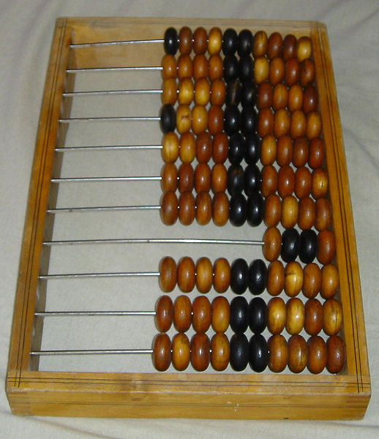
Russian multiplication
Russian abacus

Slide 20
Russian multiplication
halves,doubles=x,y
result=0
while halves:
if halves%2:
result+=doubles
halves//=2
doubles*=2

Slide 21
Python implementation - function
def russMult(x,y):
halves,doubles=x,y
count,result=0,0
while halves:
if halves%2:
result+=doubles
count+=1
halves=halves//2
doubles*=2
print("HI, I'M THE FUNCTION RUSSMULT")
print("THE MULTIPLICATION OF ", x, " AND ", y, " IS: ", result)
print("THE NUMBER OF ADDITIONS PERFORMED IS: ", count)

Slide 22
Python implementation - execution
>>> from myLib3 import *
>>> russMult(431,27)
HI, I'M THE FUNCTION RUSSMULT
THE MULTIPLICATION OF 431 AND 27 IS: 11637
THE NUMBER OF ADDITIONS PERFORMED IS: 7
>>>

Slide 23
Russian multiplication
Worst case
c =┌log₂x┐ [divisions by 2, multiplications by 2,
additions]
Eg if x = 431, c =┌log₂431┐ = log₂512 = 9
[as in our example]
x < 10^{m}
log₂x < log₂(10^{m}) = m*log₂10 ≈ 3.322 m O(m)
c =┌log₂x┐ < ┌ m*log₂10 ┐ ≤ └m*log₂10 ┘
Eg c ≤ └ 3.322*3 ┘ = └ 9.966 ┘ = 9

Slide 24
Efficiency of Multiplication Methods
24
American method O(n²)
British method O(n²)
Multiplying through addition O(10^{n})
Russian method O(n)

Slide 25
In Assignment 1
Implement the four multiplication algorithms in Python. Submit program code + screenshots of execution. Check number of additions and compare with theoretical expectation. More details in the Assignment document.

